Slide 1
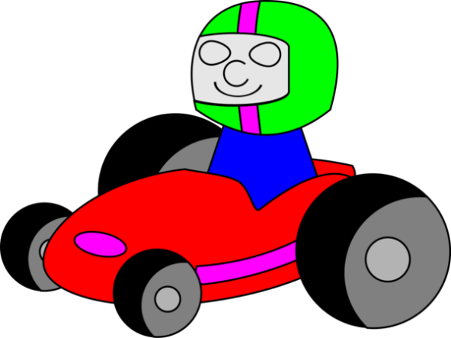


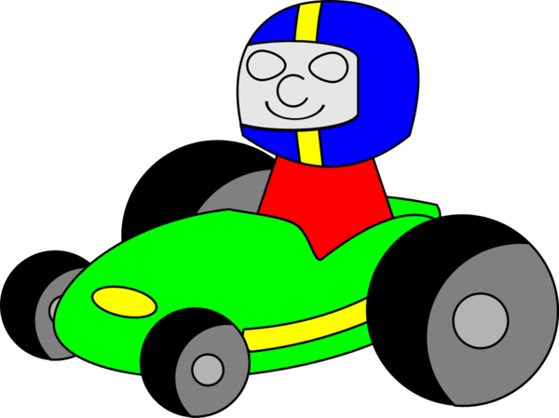
Welcome to the Pre-Prix!
Anyone over 5 years old must
be accompanied
by a Cubbie

Slide 2
